Slide 1

Introduction
COVID-19 Pandemic: A Global Health Analysis.
The COVID-19 pandemic has been a defining global health crisis of our time, profoundly impacting societies and economies. Comprehensive data analysis is critical to understanding the spread of the virus, the efficacy of public health interventions, and the pandemic's broader implications. This project aims to dissect and interpret extensive COVID-19 data to glean insights into infection rates, mortality, healthcare capacity, and vaccination progress worldwide.

Slide 2

Objective
The primary objective of this project is to analyze COVID-19 data to:
Track the spread and impact of the virus across different regions and times. Assess the effectiveness of public health measures and vaccination campaigns. Provide actionable insights to policymakers and health professionals for targeted interventions.

Slide 3

Goal
The overarching goal of this analysis is to support evidence-based decision-making and contribute to the global effort to mitigate the pandemic's effects. By providing a detailed analysis of case trends, death rates, healthcare system readiness, and population immunity levels, we aim to facilitate a data-driven approach to managing current and future public health challenges.

Slide 4

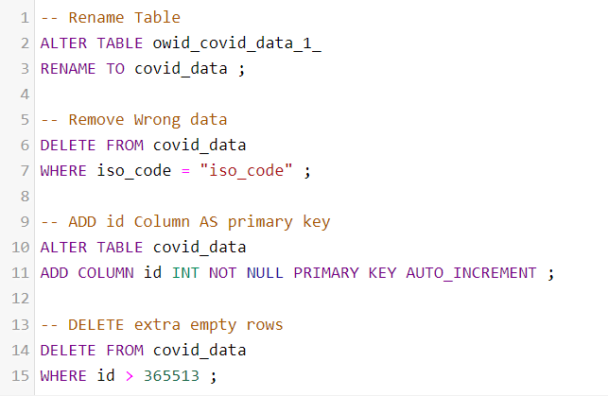
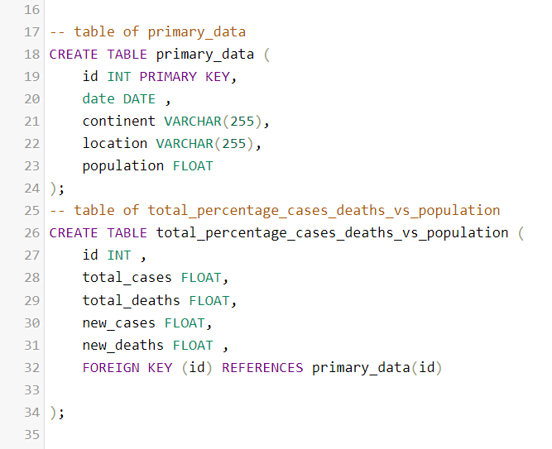
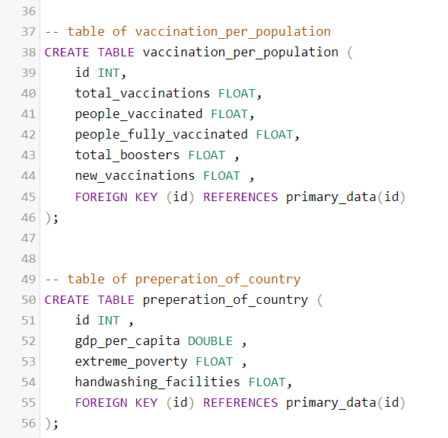
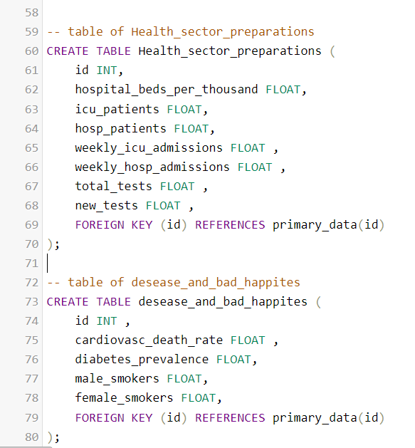
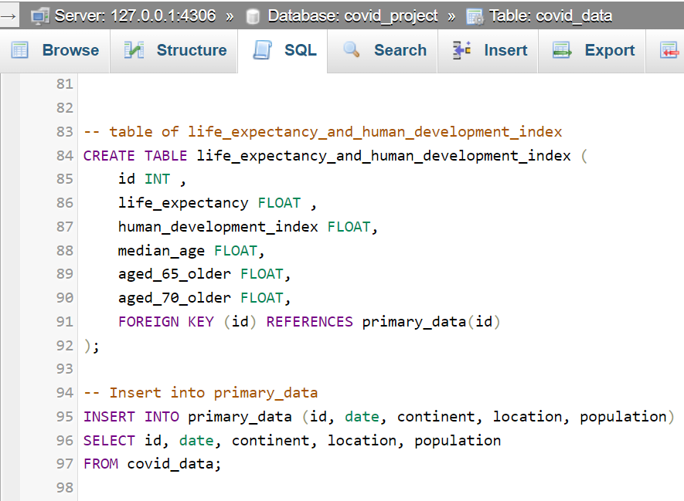
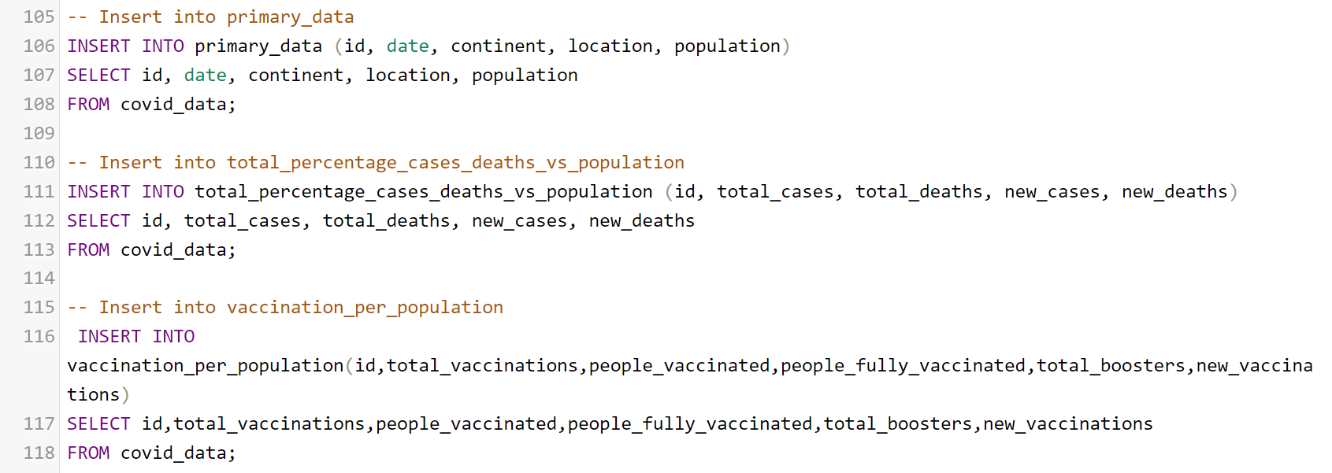
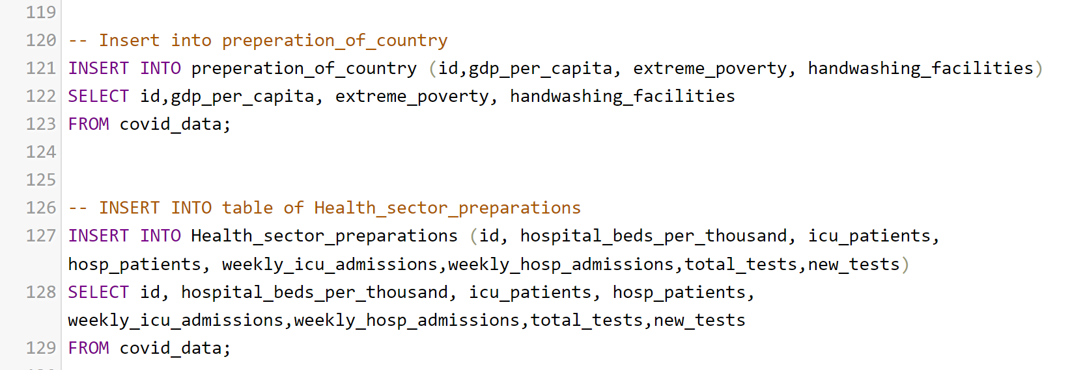
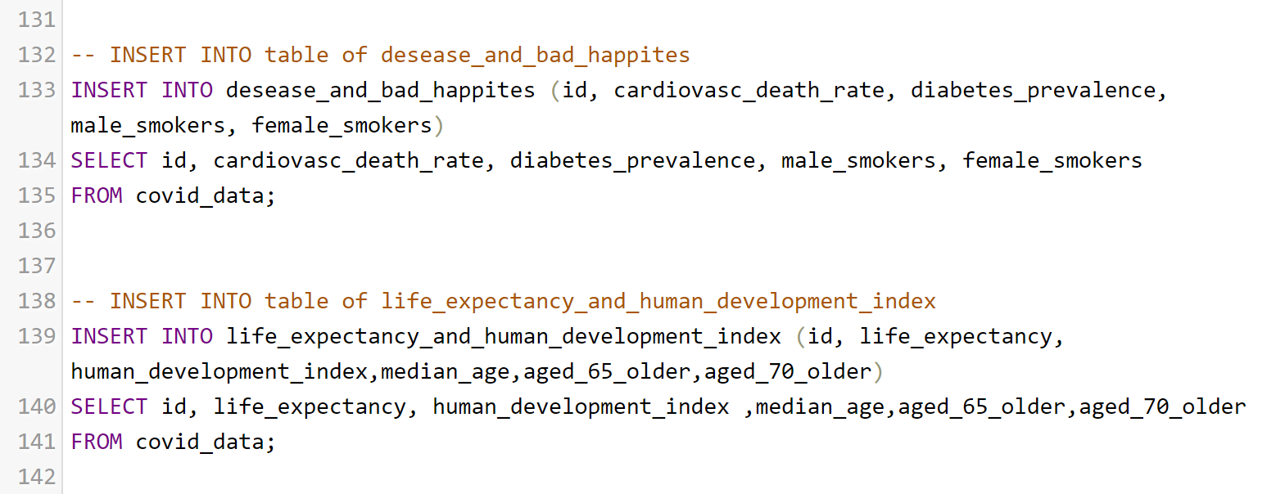
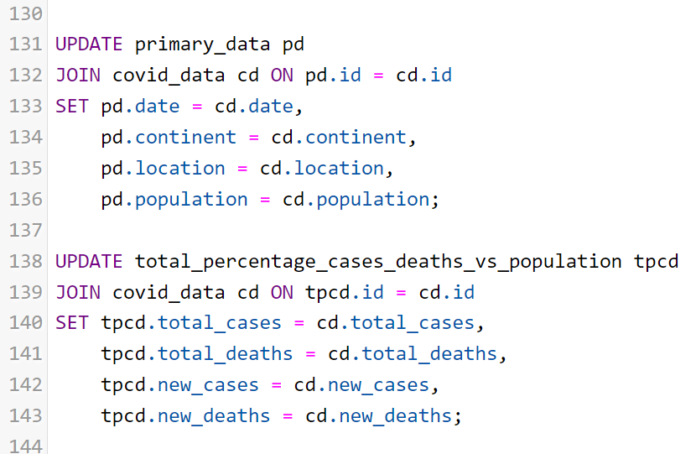
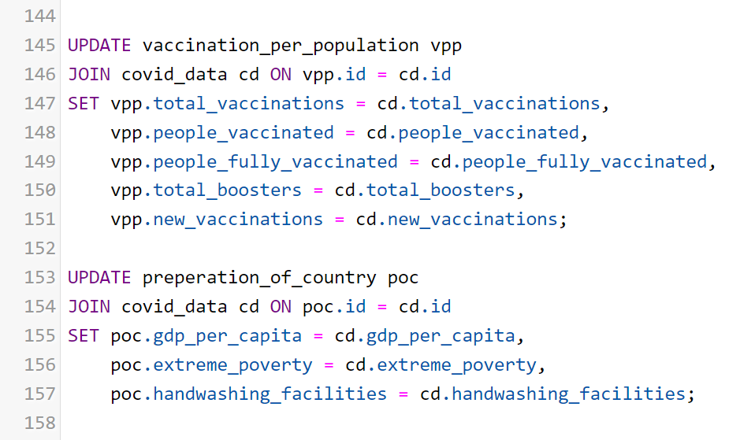
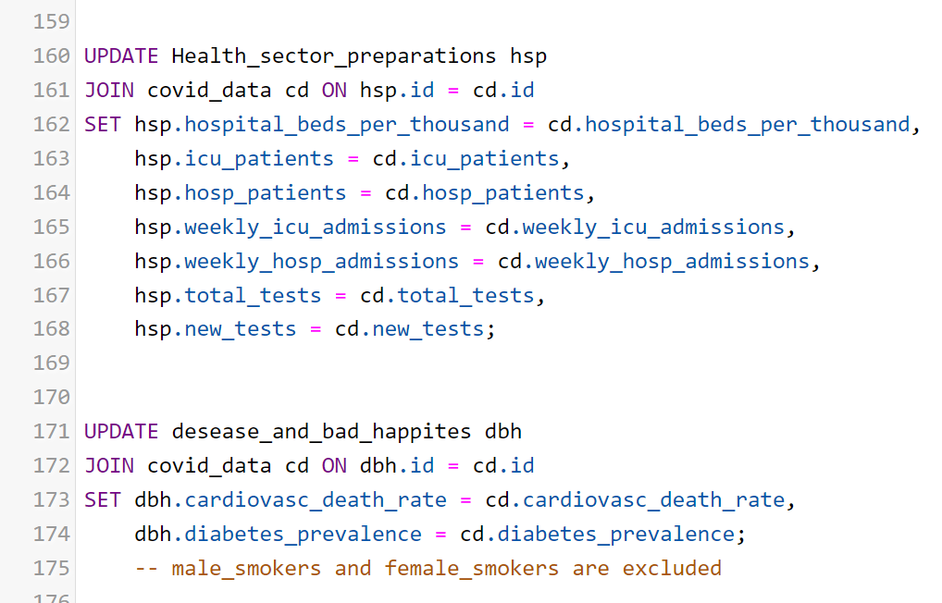
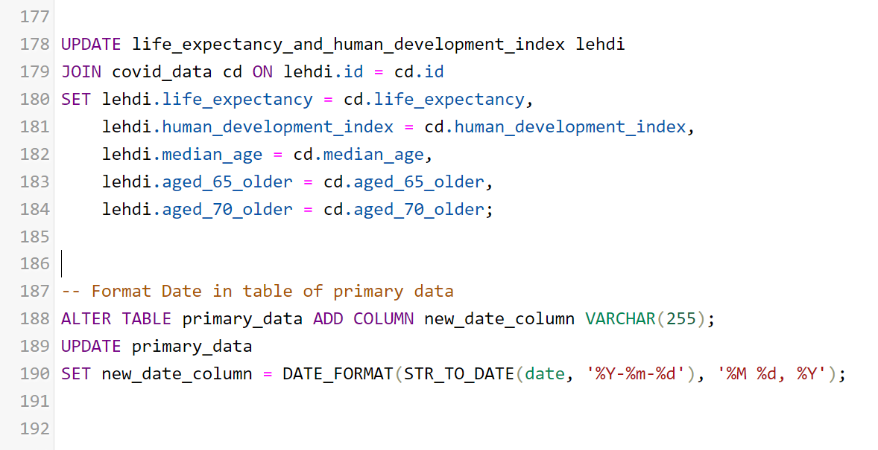
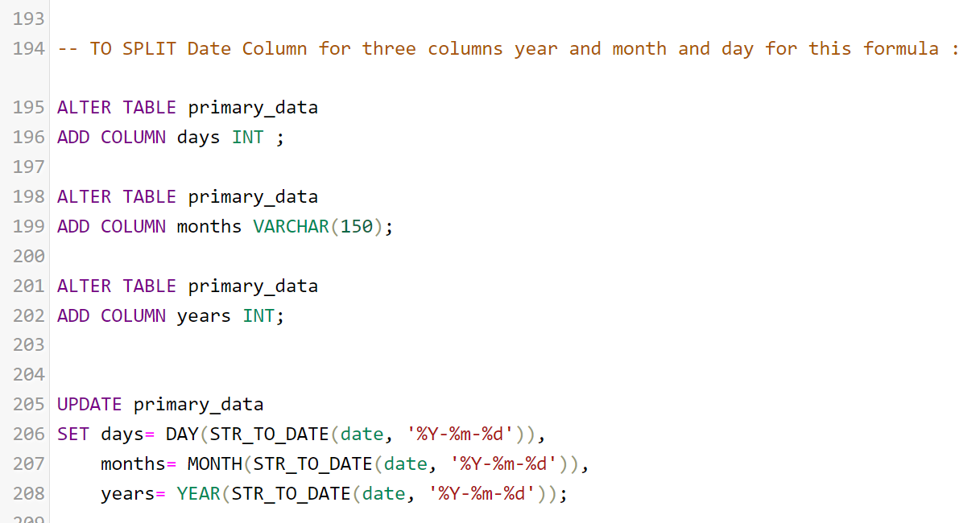
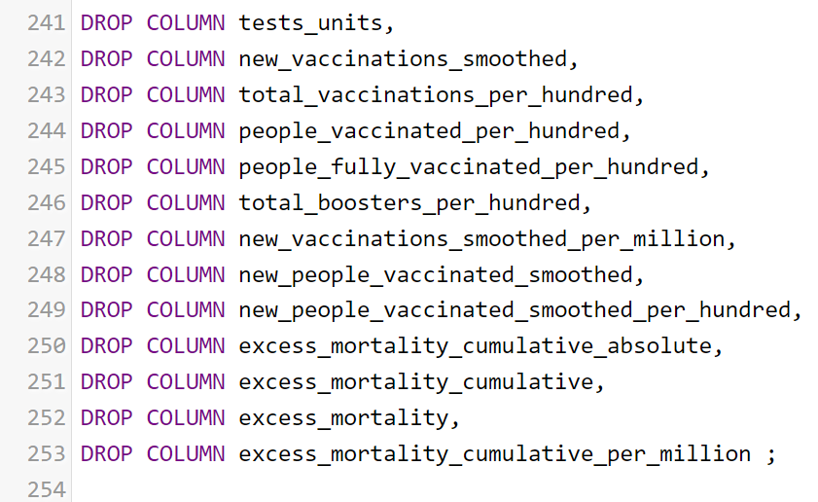
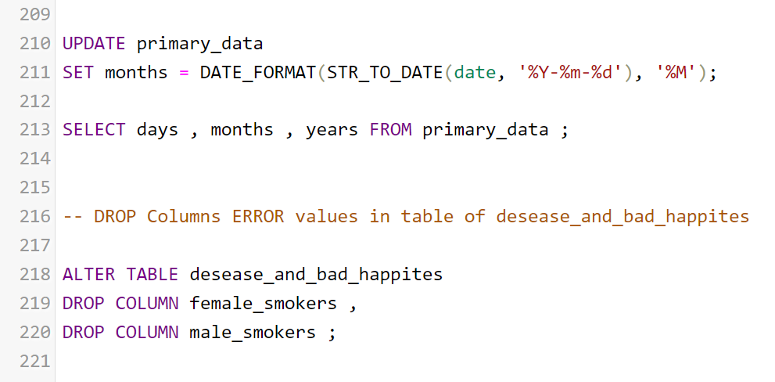
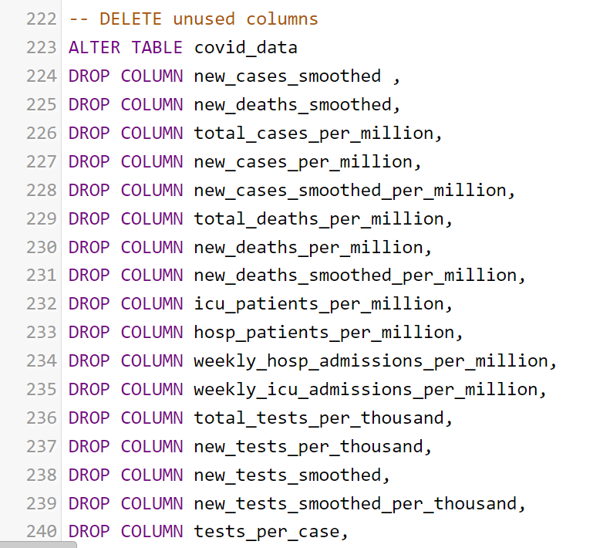
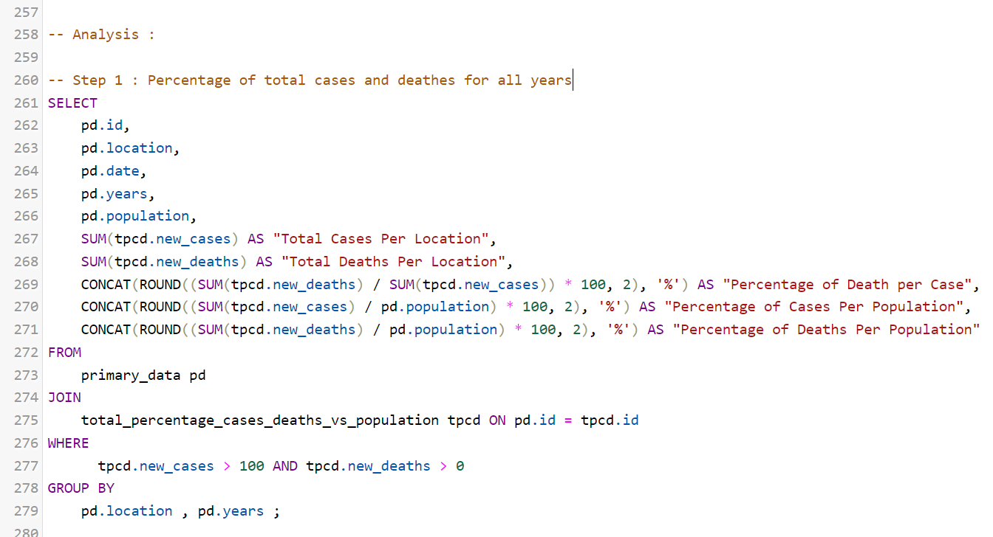
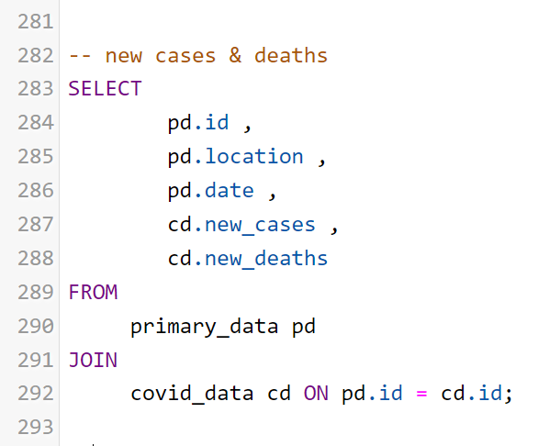
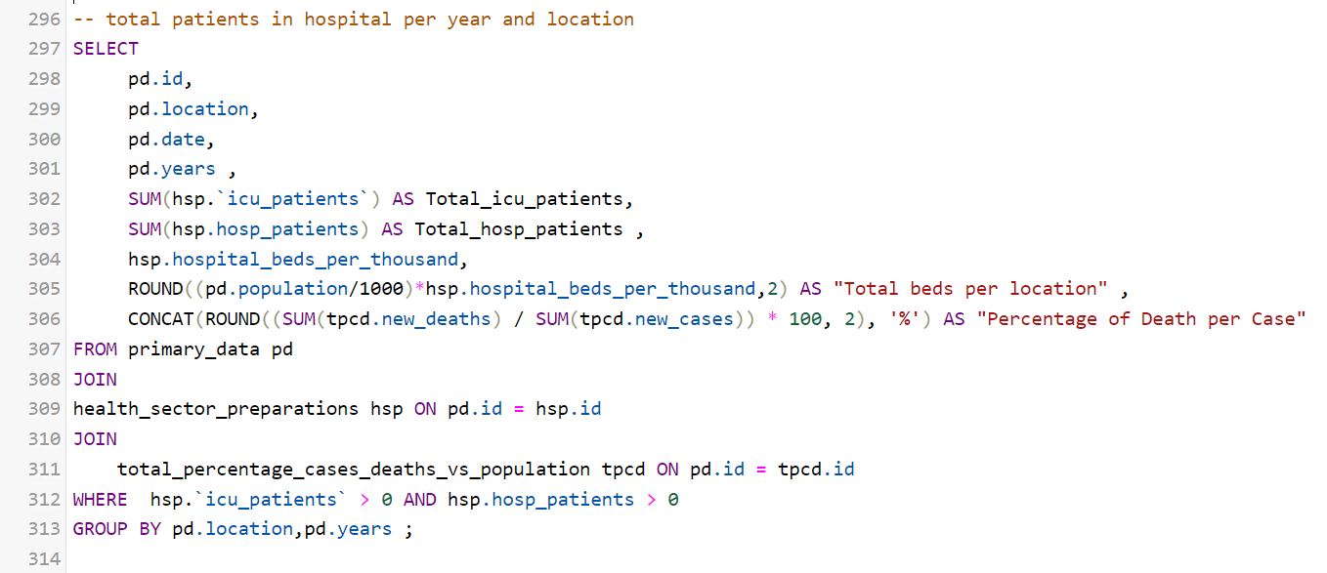
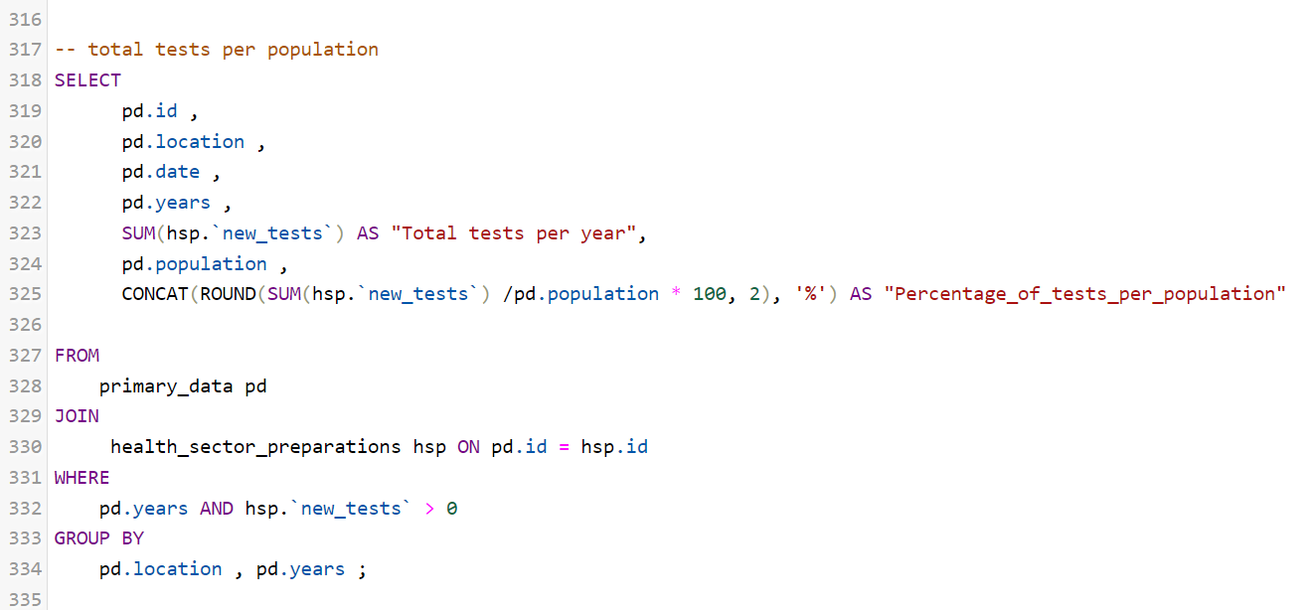
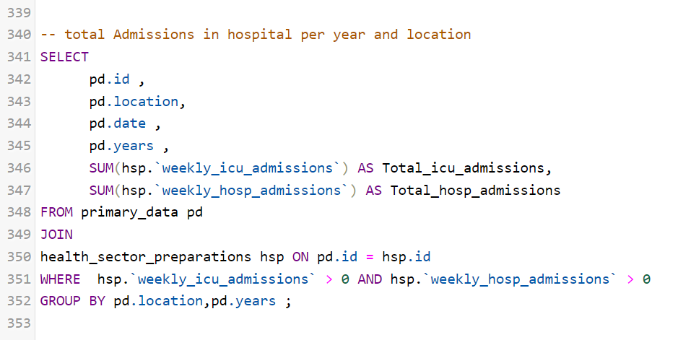
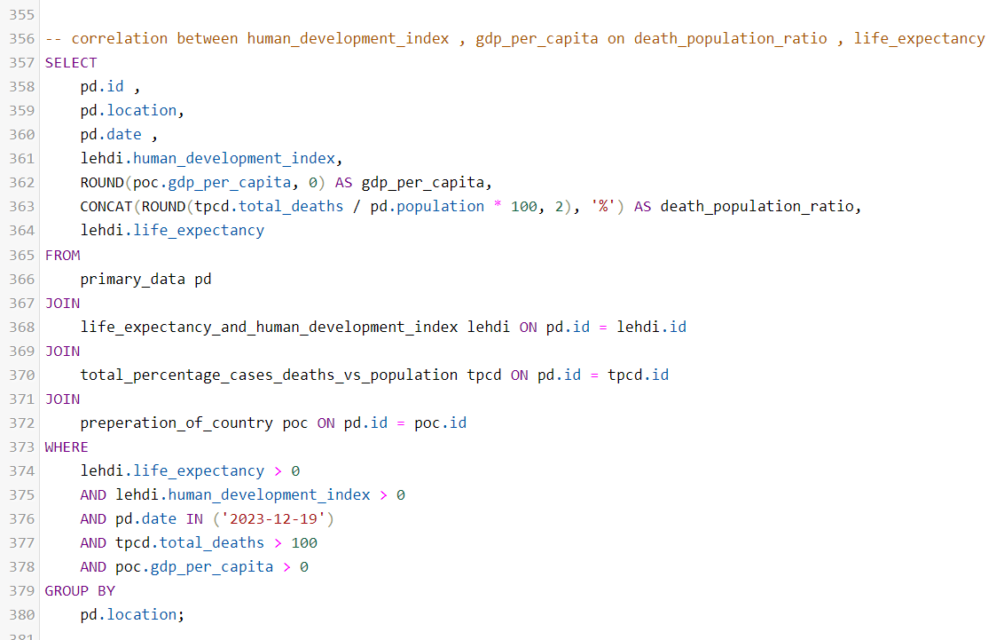
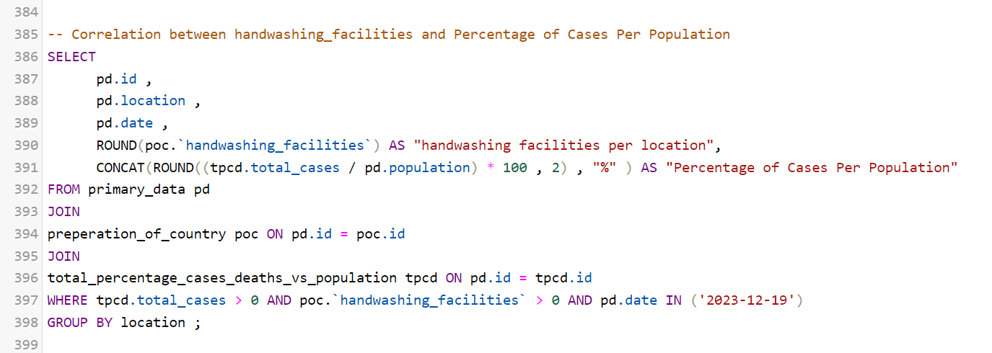
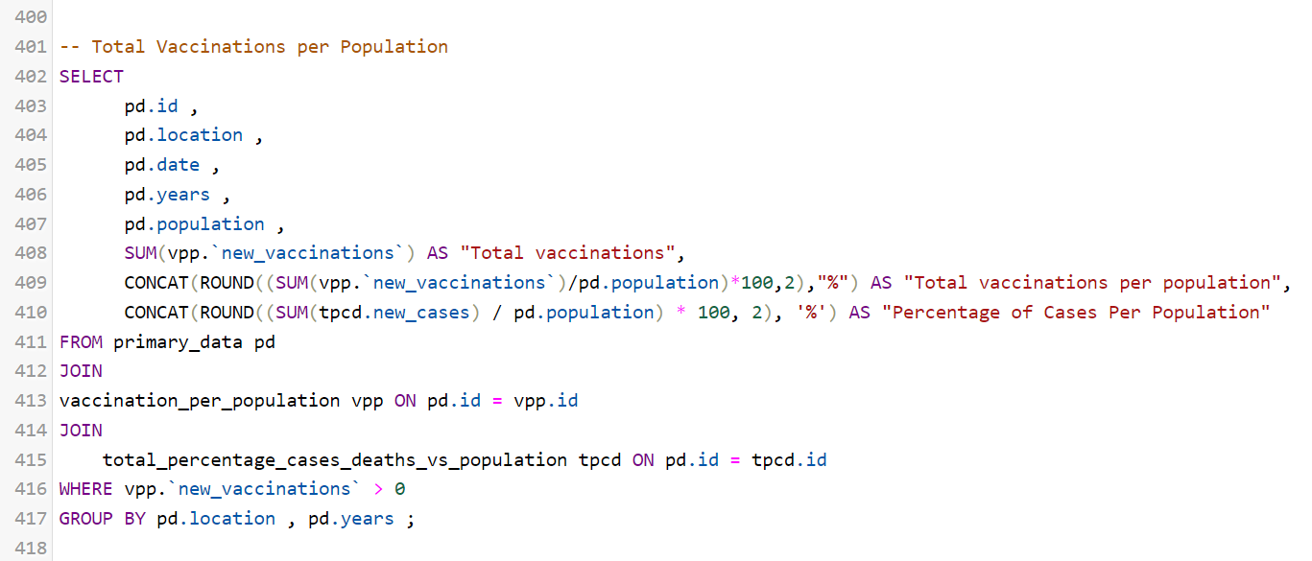
Data Wrangling :
Import Data Source Sheet and
Prepare it by :
1- rename table
2- remove wrong data
3- Add Id Column
4- Delete Extra empty rows

Slide 5

Divide the data source table into several smaller tables with fewer columns to make it more manageable
Set a foreign key in each table to facilitate joining all the tables together.

Slide 6

These two tables, among many others created from the data source, are connected to the original table (Primary Data) via the primary key "id."

Slide 7

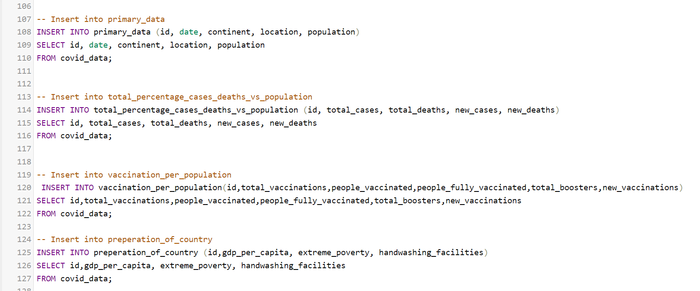
These two tables, among many others created from the data source, are connected to the original table (Primary Data) via the primary key "id."

Slide 8

These table, among many others created from the data source, are connected to the original table (Primary Data) via the primary key "id

Slide 9

This is the process of inserting data into the columns of the created tables.

Slide 10

This is the process of inserting data into the columns of the created tables.

Slide 11

This is the process of inserting data into the columns of the created tables.

Slide 12

This is the process of joining tables together by performing a full outer join on the primary data key of each table.

Slide 13

This is the process of joining tables together by performing a full outer join on the primary data key of each table.

Slide 14

This is the process of joining tables together by performing a full outer join on the primary data key of each table.

Slide 15

This is the process of joining tables together by performing a full outer join on the primary data key of each table.
Formatting the Column date of the primary data.

Slide 16

Split Date Column to Year , Month , Day Columns then format it

Slide 17
Drop Error Data Column from tables

Slide 18

Drop Unused Data columns

Slide 19

Drop Unused Data columns

Slide 20

Data Analysis :
This SQL query calculates and selects the total cases and deaths due to a certain condition (like a disease) per location and year, along with the percentage of cases and deaths relative to the total number of cases and the population. It only includes records where there are more than 100 cases and at least one death, grouping the results by location and year. The data is joined from two tables: 'primary_data' and 'total_percentage_cases_deaths_vs_ population' based on a matching id.

Slide 21

This SQL query selects the ID, location, and date from the 'primary_data' table and the number of new cases and deaths from the 'covid_data' table. It performs a join between these two tables where the IDs match, indicating it is retrieving COVID-19 related data such as new cases and deaths for each location and date in the dataset.

Slide 22

This SQL query selects data related to hospital capacity and COVID-19 impact per year and location. It retrieves the total number of ICU and hospital patients, hospital beds per thousand people, and calculates the total beds per location. It also calculates the percentage of deaths per case of COVID-19. The query joins three tables: 'primary_data', 'health_sector_preparations', and 'total_percentage_cases_deaths_vs_population', filtering for records where there are patients in ICU and hospitals. The results are grouped by location and year.

Slide 23

The SQL query calculates the total number of COVID-19 tests conducted per year and the percentage of tests relative to the population for each location. It selects the ID, location, date, year, and population from the 'primary_data' table and sums the 'new_tests' from the 'health_sector_preparations' table. The query performs a join on the matching ID between these tables and only includes records where the number of new tests is greater than zero, grouping the results by location and year.

Slide 24

The SQL query retrieves the total number of weekly admissions to ICU and hospitals per year and location. It selects identifiers, location, date, and year from the 'primary_data' table and sums the ICU and hospital admissions from the 'health_sector_preparations' table. The query includes records with more than zero admissions for both ICU and hospitals, joining the two tables on a matching ID and grouping the results by location and year.

Slide 25

The SQL query is designed to explore the correlation between human development index (HDI), GDP per capita, and the ratio of deaths in the population, as well as life expectancy. It selects data such as the location, date, human development index, GDP per capita rounded to no decimal places, the percentage of total deaths per population, and life expectancy. The query joins several tables: 'primary_data', 'life_expectancy_and_human_development_index', 'total_percentage_cases_deaths_vs_population', and 'preparation_of_country'. It filters for records with non-zero life expectancy, HDI, deaths over 100, and positive GDP per capita on a specific date ('2023-12-19'), grouping the results by location.

Slide 26

This SQL query is designed to investigate the relationship between the availability of handwashing facilities and the percentage of COVID-19 cases per population in different locations. It selects identifiers, location, date, and rounds off the number of handwashing facilities, calculating the percentage of total COVID-19 cases relative to the population. The data is obtained by joining 'primary_data' with 'preparation_of_country' and 'total_percentage_cases_deaths_vs_population' tables. It filters the data to include only records with a non-zero count of handwashing facilities and total cases, specifically on the date '2023-12-19', and groups the results by location

Slide 27

The SQL query aims to calculate and select the total vaccinations and the percentage of vaccinations relative to the population for each location and year. It also computes the percentage of COVID-19 cases per population. The query aggregates data from the 'primary_data' and 'vaccination_per_population' tables, joining with 'total_percentage_cases_deaths_vs_population' to provide a broader context. It filters for records with non-zero vaccinations, grouping the results by location and year to facilitate analysis by demographic segments.

Slide 28
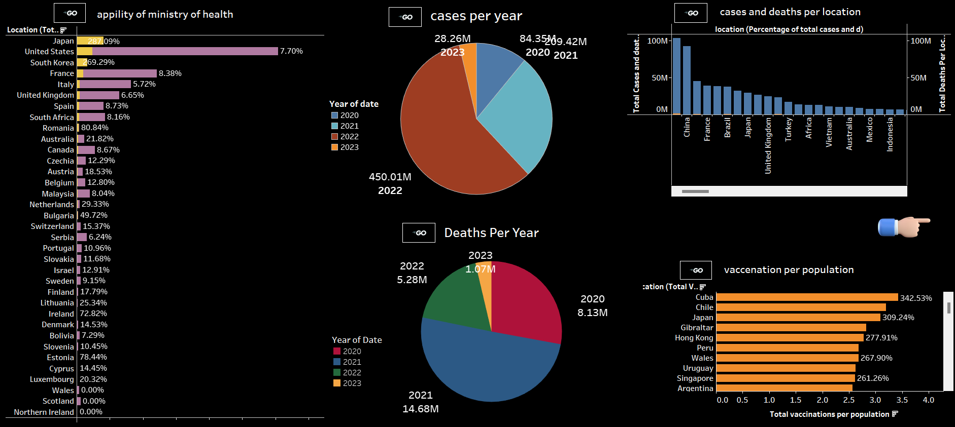
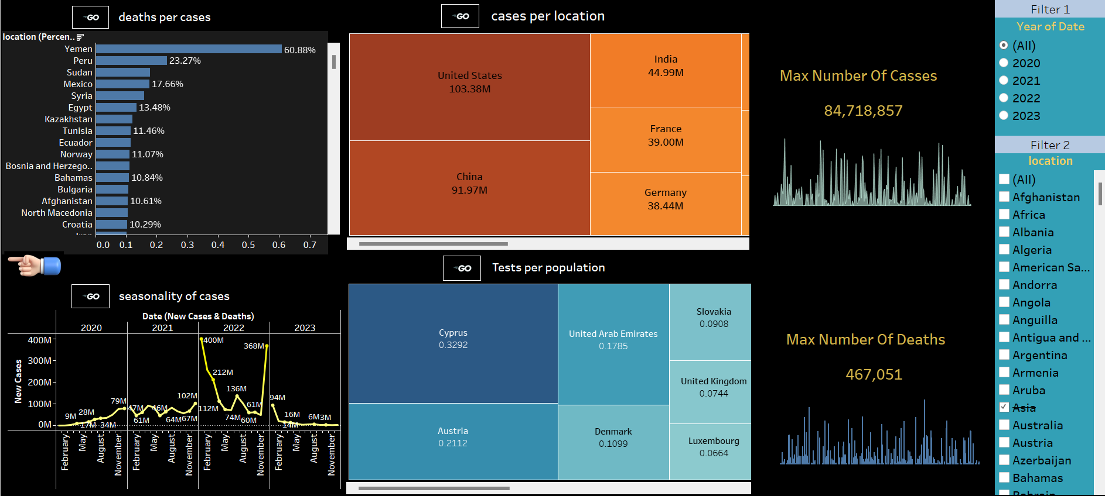
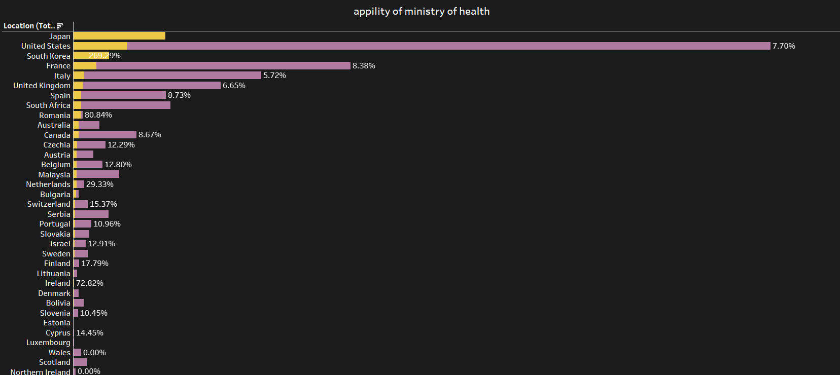
This dashboard displays various visuals, including:
The capability of the Ministry of Health
Cases and deaths per year
Cases and deaths per location
Vaccination per population

Slide 29
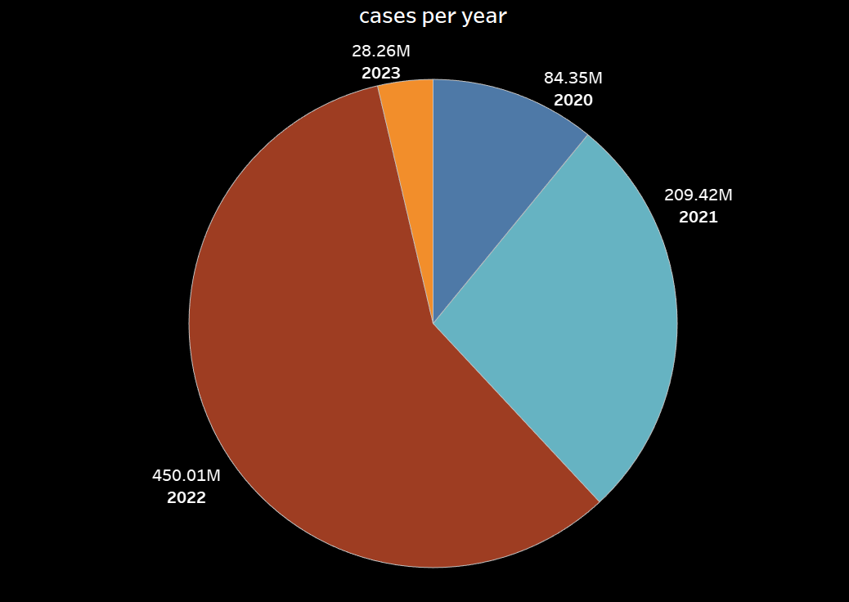
This dashboard presents a range of visuals, such as:
The percentage of deaths per case
Cases by location
Seasonality of cases throughout the year
Testing rates per population
The highest numbers of cases and deaths

Slide 30
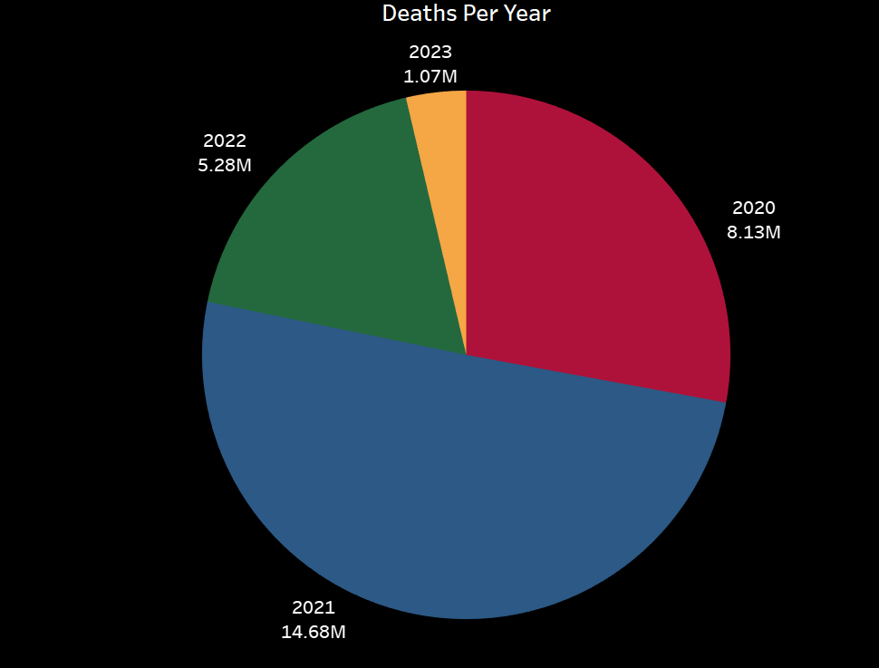
The chart indicates that Japan and South Korea lead in the average percentage of hospital beds available per patient, suggesting that they have a higher number of beds compared to the annual number of patients. Additionally, the United States, France, Italy, and the United Kingdom are among the top 10 countries globally regarding the percentage of hospital beds per patient, showcasing the capability and readiness of their healthcare systems or health ministries to accommodate patients.

Slide 31
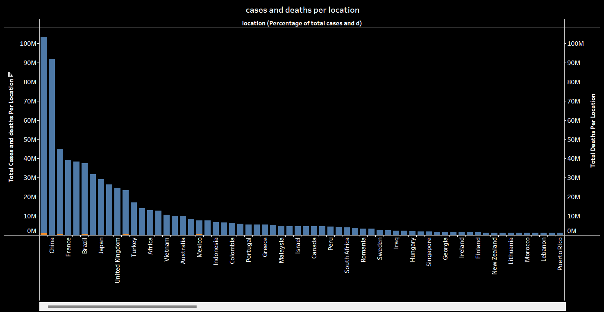
The pie chart tracks COVID-19 cases from 2020 to 2023. After a steep rise in cases from 84.35 million in 2020 to 450.01 million in 2022, there's a significant drop to 28.26 million in 2023, possibly indicating the positive impact of interventions like vaccinations and public health policies.

Slide 32
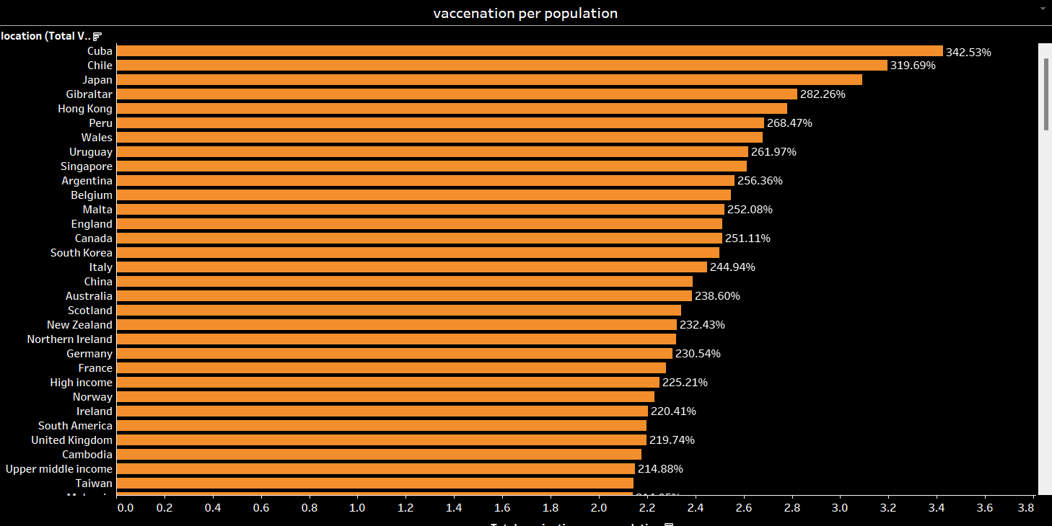
The pie chart depicts COVID-19 deaths over four years, showing a decline from 8.13 million in 2020 to 1.07 million in 2023 but it go to maximum number in 2021 by 14.68 million, suggesting improved management of the pandemic and potentially the impact of vaccination campaigns and health measures.

Slide 33
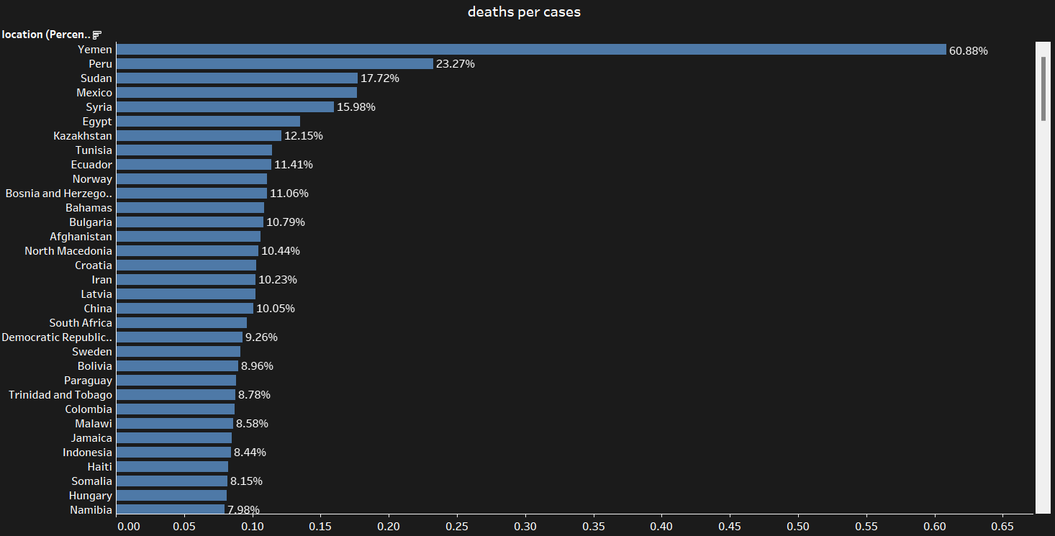
The bar chart presents total COVID-19 cases and deaths per location, with the data likely arranged in descending order of cases. China, France, and Brazil appear as the top three locations with the highest numbers, suggesting they were significantly affected by the pandemic. As we move right on the x-axis, the total cases and deaths gradually decrease. This pattern indicates a variance in pandemic severity across different locations, which could be due to factors like population density, public health policies, and access to healthcare. It's important to note that the actual insight might require more context about the data collection period, testing rates, and reporting standards in each location to understand the true impact.

Slide 34
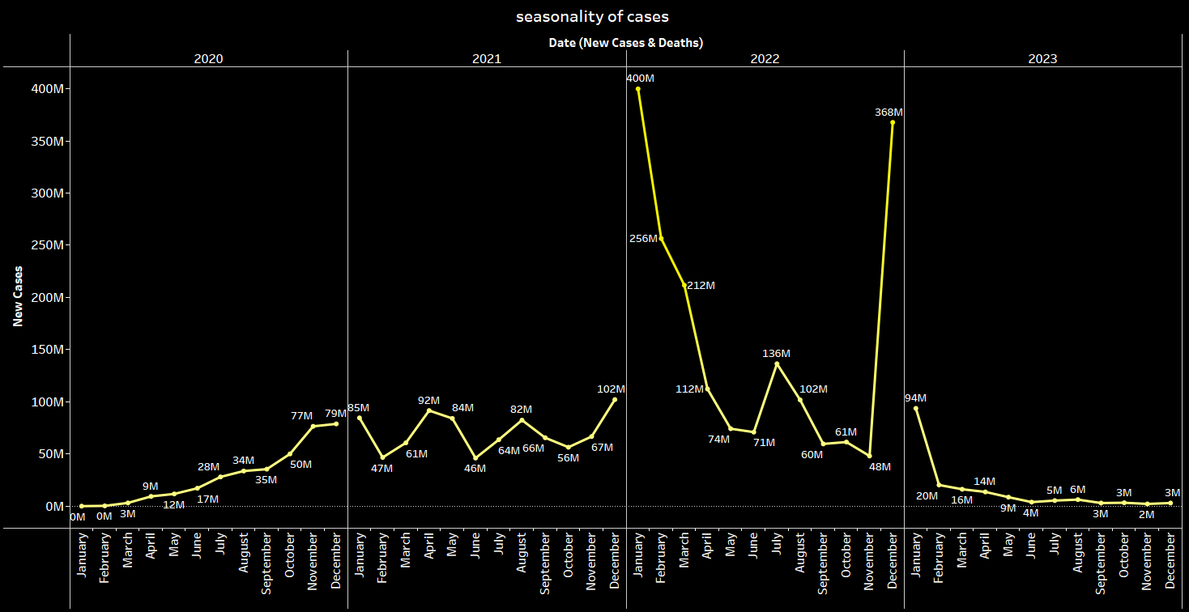
This chart shows that Cuba, Chile, and Japan are the top three countries in the world in terms of vaccinations per capita. Conversely, the Democratic Republic of the Congo, Myanmar, and Burundi are the three countries with the lowest vaccination rates globally.

Slide 35
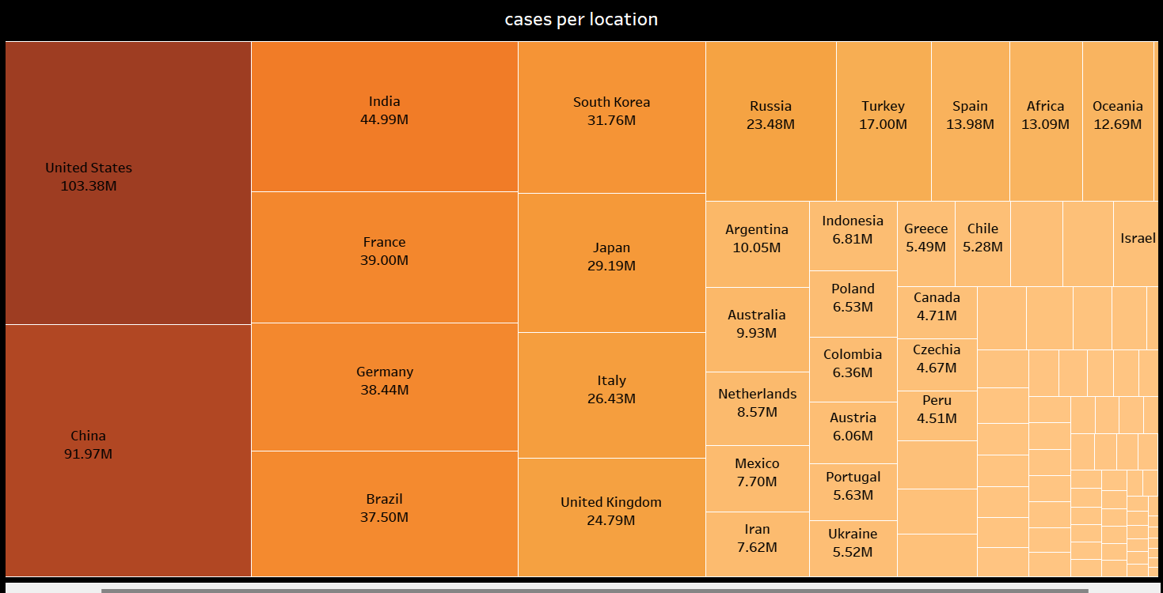
The bar graph presents a stark portrayal of the death-to-case ratio for COVID-19 by location, highlighting the disparities in case fatality rates across different countries. Yemen stands out with the highest ratio, suggesting a mortality rate of 23.27% when compared to the number of reported cases, possibly reflecting a strained or under-resourced healthcare system. This is followed by Peru and Sudan, indicating similarly critical situations.
Conversely, countries like Hungary and Namibia exhibit much lower ratios, which may indicate better medical management or reporting of COVID-19 cases. These trends could also reflect differences in population demographics, healthcare access, or the presence of underlying health conditions among the populace. The data underscores the varied impact of the pandemic across the globe, emphasizing the need for context-specific responses and support for regions with higher mortality ratios.

Slide 36
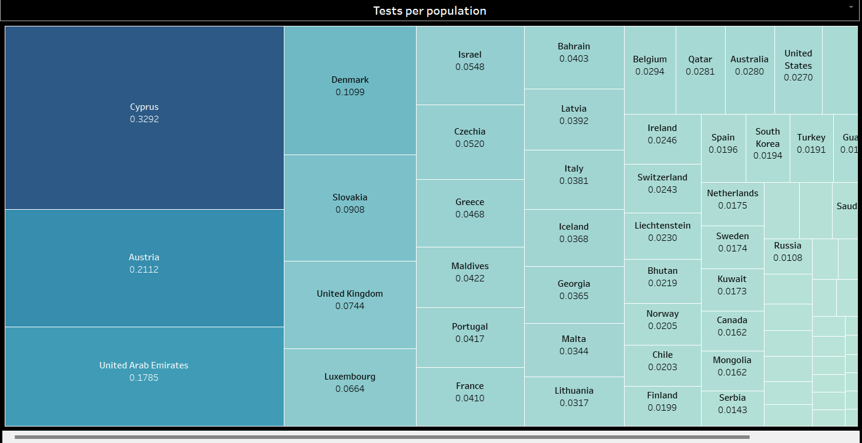
The line graph depicts the seasonality of COVID-19 cases and deaths over several years, showing a substantial peak in 2022, followed by a significant drop in 2023. This trend could indicate the impact of successful vaccination campaigns, natural immunity buildup, or changes in virus transmissibility. The seasonal spikes suggest that factors such as weather changes and social behavior may also play a role in the spread of the virus. The data points to a hopeful decline in cases and deaths, but continued vigilance is necessary to maintain this trajectory and manage potential future outbreaks.

Slide 37
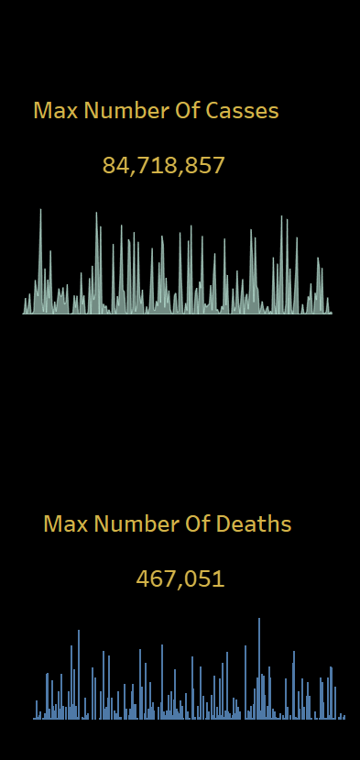
The treemap highlights the distribution of COVID-19 cases by location, with larger rectangles representing a higher number of cases. The United States, India, and Brazil emerge as the countries with the most significant caseloads, which is reflective of their large populations and the intense spread of the virus within these territories. European countries like France, Germany, and the United Kingdom also show substantial case numbers. In contrast, some regions like Oceania report lower figures, which could be due to various factors such as geographic isolation, effective containment strategies, or lower population density. This visualization underscores the disparities in case distribution globally and may inform resource allocation and public health strategies.

Slide 38
The treemap for tests per population indicates a varied testing landscape across different countries. Cyprus leads with the highest testing rate per capita, followed by other nations like Austria and the United Arab Emirates, suggesting robust testing frameworks. Meanwhile, the relatively smaller rectangles for countries like the United States, South Korea, and Canada show a lower testing rate per capita. This visualization reflects each country's testing strategy, which is a crucial component in managing the pandemic, as widespread testing can lead to early detection and containment of outbreaks. It's also indicative of resource allocation towards testing facilities and the prioritization of testing in public health policies.

Slide 39
The image depicts two bar graphs labeled "Max Number Of Cases" and "Max Number Of Deaths," with the cases graph reaching a peak of 84,718,857 and the deaths graph a peak of 467,051. The data suggests significant fluctuations over time, possibly indicating waves of infection and corresponding deaths. The highest peak in cases could correspond to the peak transmission period of the pandemic or a time with the most widespread testing. The death counts seem to follow a somewhat similar pattern but with less volatility, potentially indicating lagging indicators as deaths would naturally follow cases by some time. This information underscores the pandemic's severe impact and highlights the importance of continued vigilance and public health measures to manage and prevent such peaks in the future

Slide 40

Conclusion
In conclusion, this project's analysis has shed light on the multifaceted nature of the COVID-19 pandemic. Key findings highlight the variability in response and impact across different locations and times, underscoring the importance of localized strategies. The data indicate a strong correlation between vaccination rates and a decrease in cases and mortality, emphasizing the critical role of vaccines in pandemic control. While challenges remain, particularly in ensuring equitable vaccine distribution and managing emerging variants, the insights from this project can guide ongoing efforts to control the pandemic and prepare for future health crises. For each set of images related to specific aspects of your project (e.g., hospitalization rates, vaccination coverage, etc.), you would typically tailor these sections to focus on the particular theme and findings that those images represent. If you have specific key points or findings from the images you’d like to include in these sections, please let me know so I can incorporate those into the framework provided above.

